Slide 1
pH Testing for correct placement of nasogastric tubes
South Western Sydney Local Health District
Prepared by Education and Organisational Development Service
June 2024

Slide 2
Learning Outcomes
Raise staff awareness of confirmation of correct placement of nasogastric tubes on insertion, using pH testing and Chest X-Ray
Explain the importance of confirming NG tube placement
Discuss the limitations and potential false readings associated with pH testing
Demonstrate how to collect and test NG tube aspirates for pH testing
Evaluate signs and symptoms indicating incorrect placement and escalation process
South Western Sydney Local Health District

Slide 3
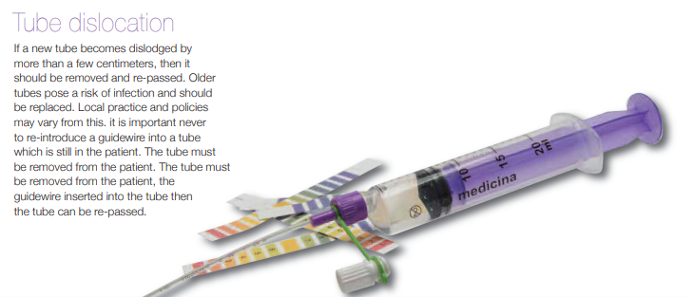
Change in policy to confirmation of NG correct placement
SWSLHD_CN2024_008
Insertion and Management of Nasogastric and Orogastric Tubes in Adults
South Western Sydney Local Health District
Notes:
Prompt Question: Why is confirming NG tube placement crucial for patient safety?
Potential responses:
Preventing Aspiration: Correct NG tube placement ensures that the tube is in the stomach, not the lungs. Incorrect placement can lead to aspiration pneumonia, a serious condition where stomach contents enter the lungs.
Optimising Nutrition and Medication Delivery: Properly positioned NG tubes allow for effective feeding and medication administration. Incorrect placement may result in inadequate nutrition or medication delivery.
Avoiding Injury: Incorrectly placed NG tubes can damage the nasal passages, throat, oesophagus, or stomach. Confirming placement helps prevent harm to the patient’s airway and organs

Slide 4
Methods testing correct placement
1st line of Checking
Non-Radiological confirmation
pH Testing
2nd line of Checking
Radiological
confirmation
CXR
Notes:
There are two ways to confirm placement - radiological and non-radiological confirmation. Emphasise pH testing is new to practice to confirm NG placement. It does not mean we still do not use CXR. There are specific criteria and indications for the need to use CXR

Slide 5
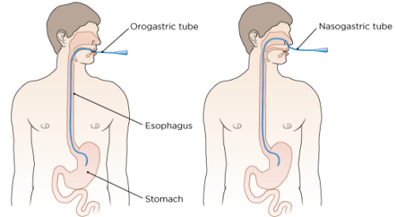
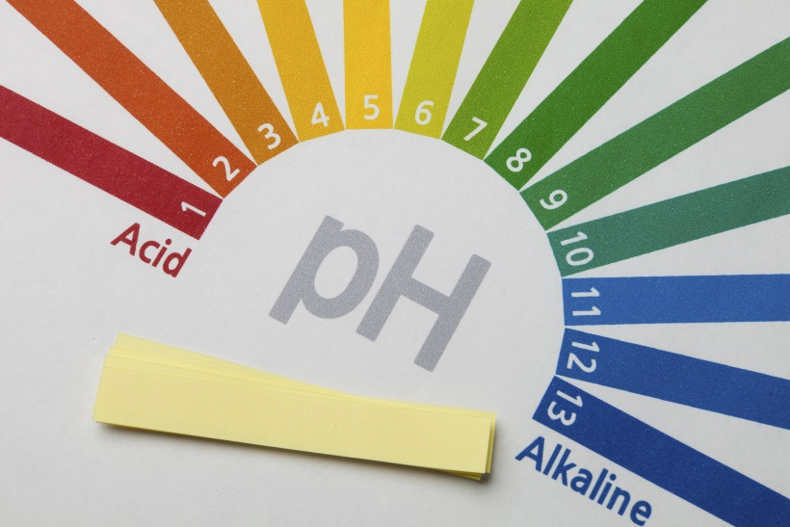
Purpose of pH testing
Confirming Placement
  Ensuring the tube is correctly positioned in
  the stomach
Monitoring Gastric Acidity
  Assessing stomach pH levels, important for various medical conditions and treatments
Notes:
Discuss the purpose of pH testing and reinforce that this presentation is focussing on PH Testing for NGT placement only.
Prompt Question: How does pH testing help confirm NG tube placement?
Potential responses:
A. Gastric pH vs. Respiratory pH:
Gastric content has a low pH (1.5-3.5) due to stomach acid.
Respiratory secretions have a higher pH (usually around 7).
By testing the pH of NG aspirate, healthcare professionals can differentiate between stomach and lung placement. Gastric pH confirms safe placement in the stomach.
B. Colour Change Indicators:
pH testing strips change color based on the pH level.
If the aspirate turns acidic (pH < 5), it suggests gastric placement.
Alkaline aspirate (pH > 6) indicates potential lung placement.
C. Clinical Practice Guidelines:
Many hospitals follow evidence-based guidelines for NG tube placement.
pH testing, along with other methods (such as X-rays), ensures accurate placement.
Regular assessment and documentation are essential for patient safety.

Slide 6
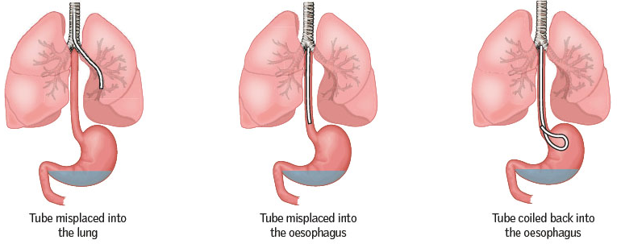
Importance of pH testing
  Prevents complications like aspiration pneumonia
  Ensures effective treatment administration
Notes:
Discuss the importance of pH testing and complications when NGT is not positioned appropriately:
Aspiration pneumonia
Pneumothorax
Pressure injury
Oesophageal perforation
Pleural cavity perforation
Death

Slide 7
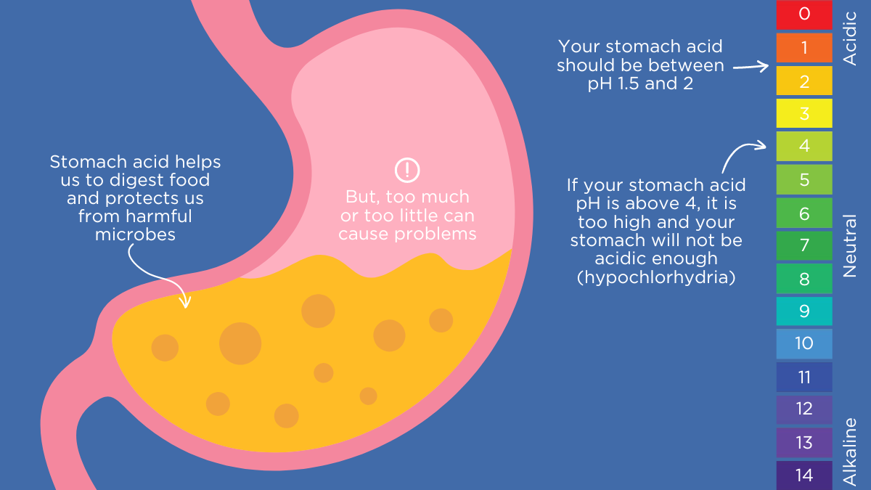
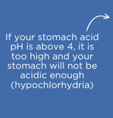
Normal gastric pH
5
Notes:
Normal Gastric pH: Typically between 1.5 to 2
Abnormal pH Readings:
pH < 1.5: May indicate hyperacidity or recent ingestion of acidic substances.
pH > 5: Indicates incorrect placement, requiring repositioning.

Slide 8
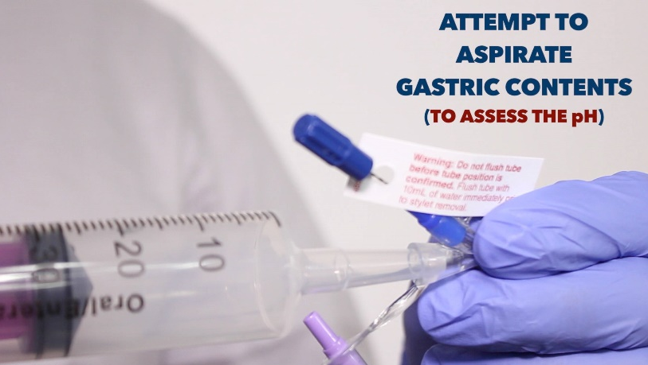
pH testing
Test pH of aspirate using pH indicator strips
  Gastric pH of less than or equal to 5 indicates correct gastric placement
  For initial placement, if pH is greater than 5, CXR is indicated
Notes:
pH testing – and results we must meet to deem safe to use

Slide 9
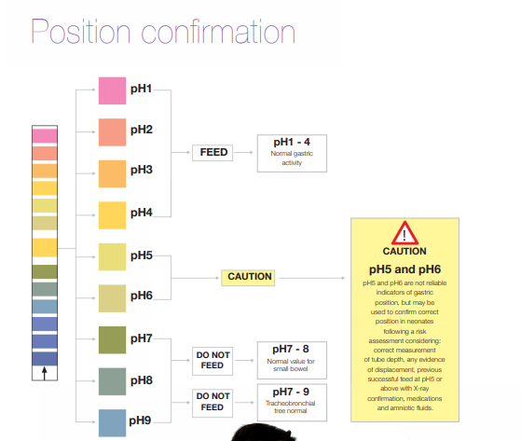
Drop gastric fluid here

Slide 10
pH testing complications
Never use auscultation as a form of tube position confirmation
Never use litmus paper to confirm pH
pH testing can be limited in continuous feeding or when using acid suppression therapy as this may have a neutralising effect on gastrointestinal pH. This may see a pH greater than 5 which would indicate the need to proceed to x-ray confirmation
Notes:
Discuss complication with inaccurate pH results obtained
Avoided Methods: Highlight methods that should never be used (e.g., auscultation, litmus paper).
Key Question: Why are these methods unreliable?
Potential responses:
A. Auscultation (Listening for Air Bubbles):
Auscultation involves listening for air bubbles when injecting air into the NG tube.
Limitations:
Air bubbles can be present even if the tube is in the lungs (e.g., due to oesophageal placement).
False negatives occur when no bubbles are heard despite incorrect placement.
Variability in clinician hearing and patient factors affects reliability.
B. Litmus Paper (Colour Change):
Litmus paper changes colour based on pH.
Challenges:
Gastric aspirate may not always be acidic (e.g., in patients on acid-suppressing medications).
Litmus paper lacks precision and sensitivity.
False results can lead to incorrect placement decisions.

Slide 11
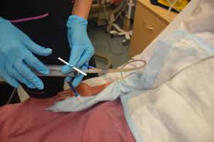
Points in care when tube placement is to be checked
At commencement of the shift and on patient transfer
Suspicion of tube displacement such as loose tape, visible tube appears long, change in cm measure at the nares, poor tolerance to feed, reflux of feed into throat, discomfort in the throat or patient pulling at the tube
Patient describes discomfort with the tube
Before enteral feeds, water and/or medication / contrast agent
When the patient is repositioned
Following episodes of respiratory distress, vomiting, retching, or coughing
Notes:
After inserting the NGT document the centimetre mark at insertion point ( nares) – if not present, document external length of tube from the nares to the base of the distal port
The position of the exit-point centimetre mark on an existing nasogastric tube must be checked by nursing staff to ensure that there has been no migration.
If there is any indication that there has been tube migration, the tube must not be used until the position of the tube in the stomach has been reconfirmed.
If the securement method is no longer effective, resecure as needed

Slide 12
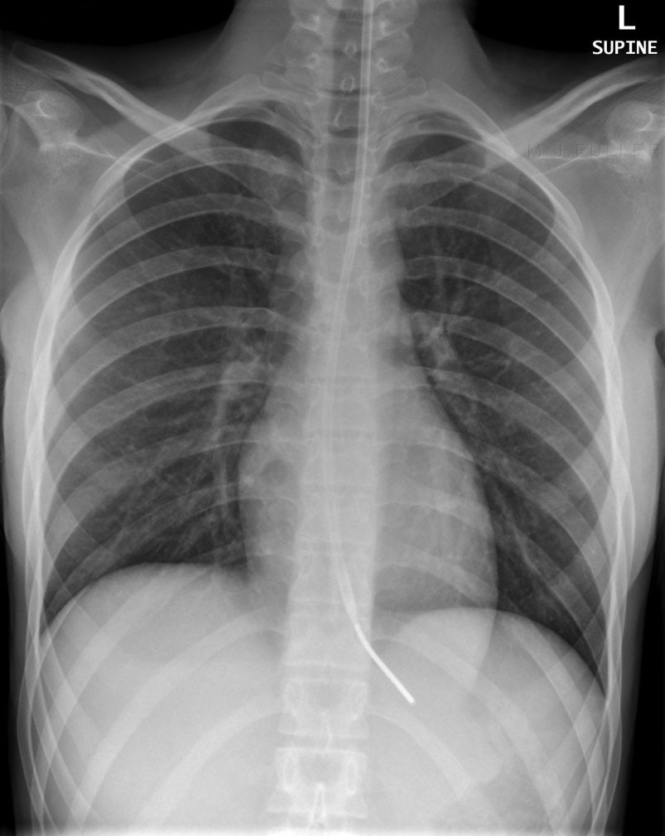
CXR (when and if required)
CXR must be ordered by a MO to confirm safe placement of a tube if:
  difficulty experienced when inserting the tube
  patient had a clinical presentation which may have increased the risk of tube
  misplacement during the insertion
  any concern about potential tube misplacement
  an aspirate cannot be obtained
  the pH testing of the aspirate is > 5
Notes:
Discuss the need of CXR t
Chest X-Ray
Explain when CXR must be ordered (E.g. for those patients whom an aspirate is unable to be obtained or aspirate pH is greater than 5)
Key Question: What other scenarios indicates the need for radiological confirmation to confirm placement, and the criteria when CXR must be ordered
Potential responses:
A. Suspicion of Incorrect Placement: When there is doubt about the tube’s position after initial insertion
B. Patient Movement or Transport: Significant movement post-procedure may displace previously confirmed placements.
C. Any answer in slide difficulty experienced when inserting the tube patient had a clinical presentation which may have increased the risk of tube , misplacement during the insertion, any concern about potential tube misplacement an aspirate cannot be obtained the pH testing of the aspirate is > 5

Slide 13
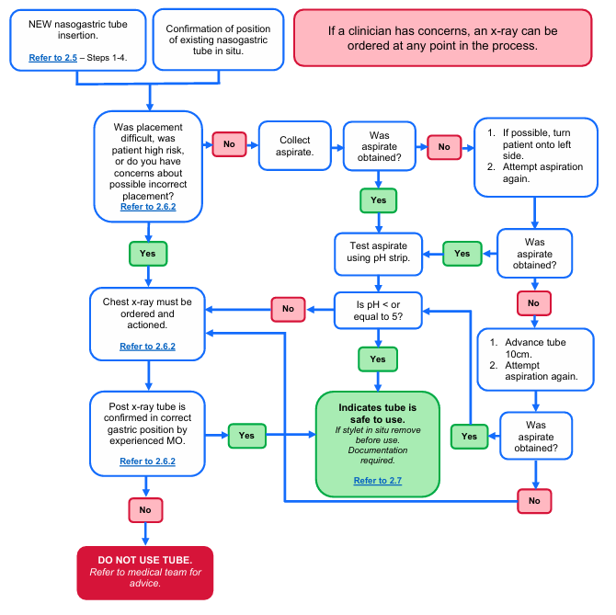
FLOW
CHART
START HERE
FLOW
CHART
Notes:
Handouts of flow chart made available to participants

Slide 14
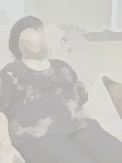
Case Scenario
Mrs. Stanley, a 70-year-old female, was admitted to the ward. She has a history of stroke and dysphagia, requiring feeding via an NG tube. You had no complications inserting the tube. You aspirate and the pH testing strip is 6.
How do you proceed?
Notes:
Use scenario to walkthrough flowchart and discuss troubleshooting issues etc
Expected response – CXR mut be ordered and actioned prior to use

Slide 15
Escalation Process
Senior Nurse
Medical Officer
Radiological Confirmation
Notes:
Escalate process when in doubt or required second opinion.

Slide 16
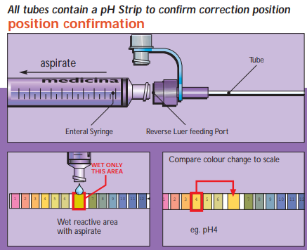
Demonstration of pH testing
Notes:
Trainer to demonstrate the use of pH testing.
Use the pH strips and allow participants time to be hands-on with the equipment

Slide 17
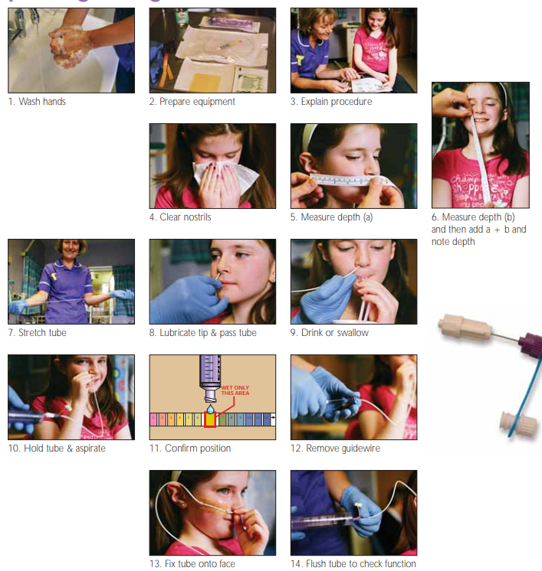
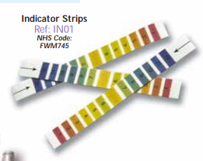
Demonstration of pH testing
Notes:
Accredited staff member to demonstrate, may provide opportunity for staff to handle the pH strips and provide a simulation with products to be used.

Slide 18
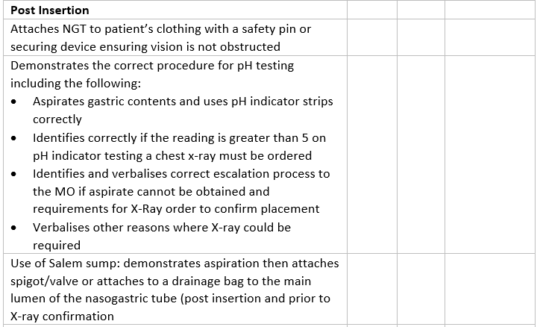
Main Changes to OA
(Practical Assessment Tool)
Notes:
Staff with existing NGT insertion accreditation will only be required to demonstrate competency in pH testing.
i.e. It is not a requirement for staff to demonstrate insertion of NGT

Slide 19
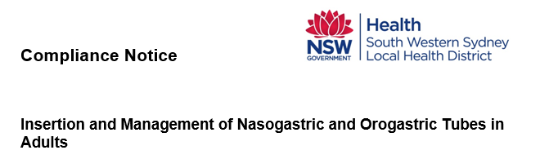
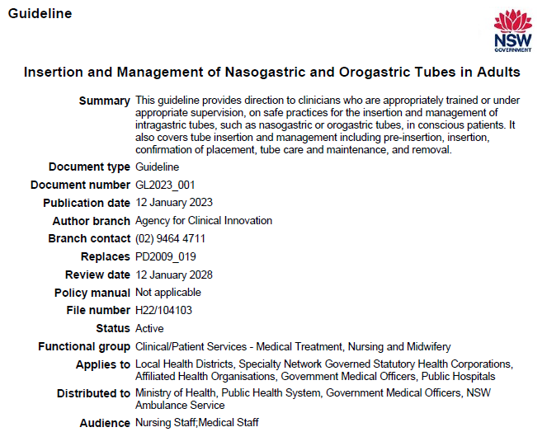
Resources and References
Operational Assessment
Guideline
Compliance notice
Product Information
        InterMed Medical Pty Limited
        Medicina (ENFit)
Notes:
Staff to be aware of new and updated resources, make this available to staff to access

Slide 20
Key Points
pH testing of nasogastric tubes is crucial for confirming placement and monitoring gastric acidity
Proper procedure and interpretation are essential for accurate results
Notes:
Emphasis to be re-accredited once pH strips arrive to facilities.
Highlight key principles.
Questions and Feedback

Slide 21
Any questions?

